Slide 1

SAVE THE PLANET 2

Slide 2
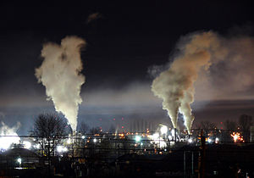
AIR POLLUTION
Using private cars
Using fossil fuels (petroleum, coal)

Slide 3
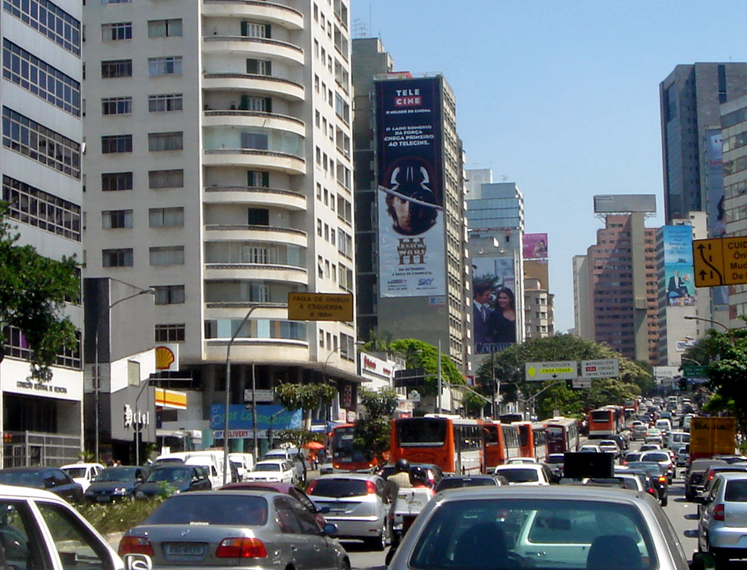
NOISE POLLUTION
Car honks
Loud music

Slide 4
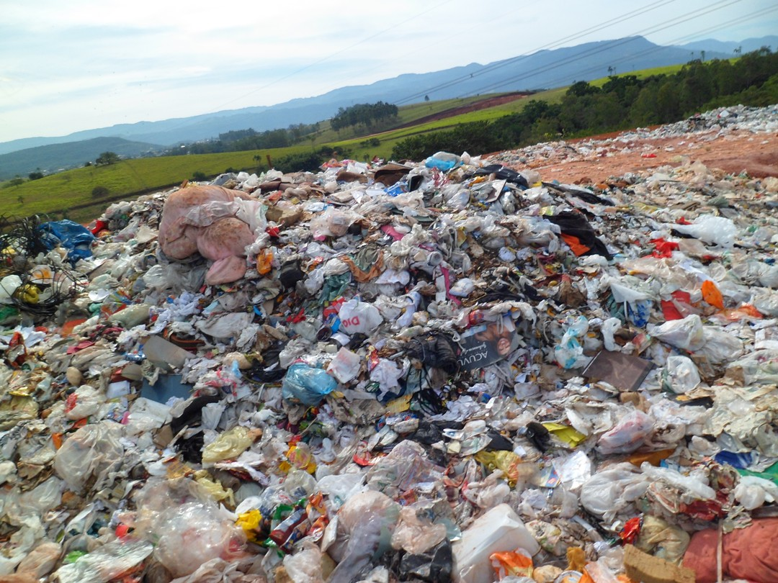
LAND POLLUTION
Dropping litter on the land
Not recycling waste

Slide 5
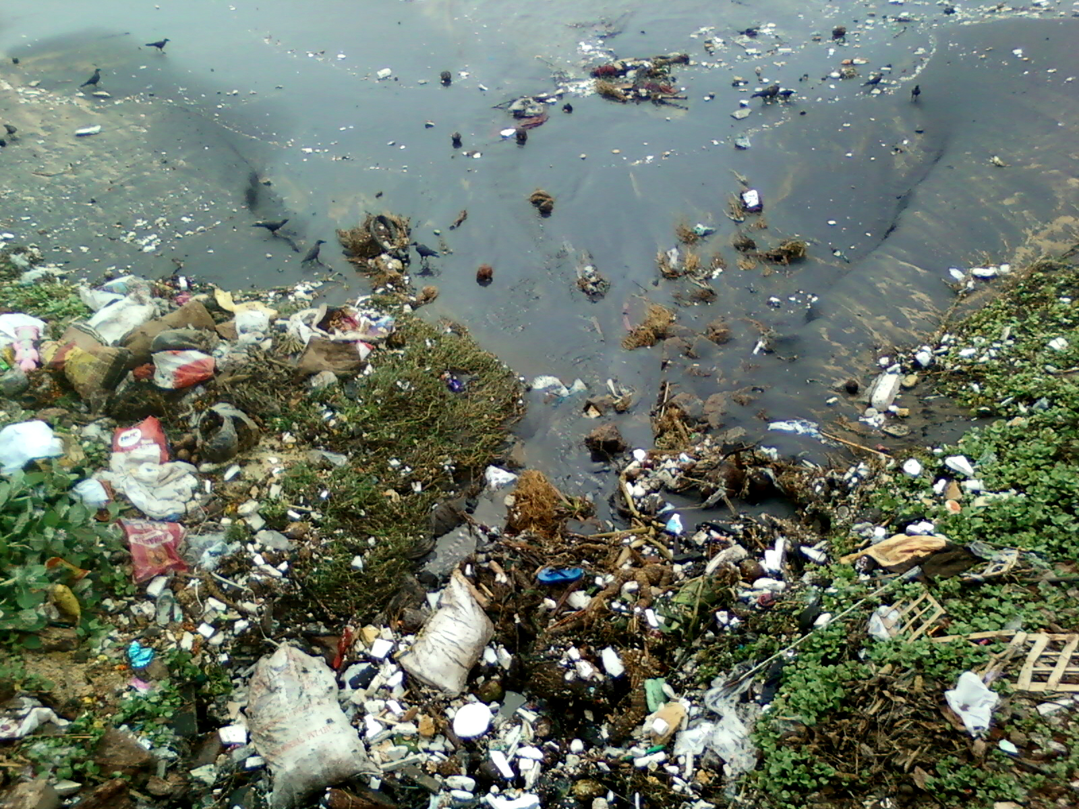
WATER POLLUTION
Not recycling your waste
Letting oil down the drain

Slide 6
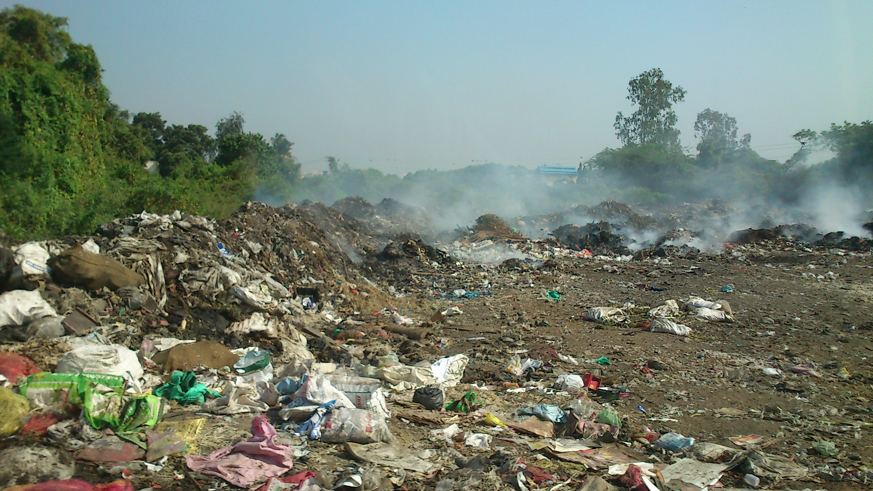
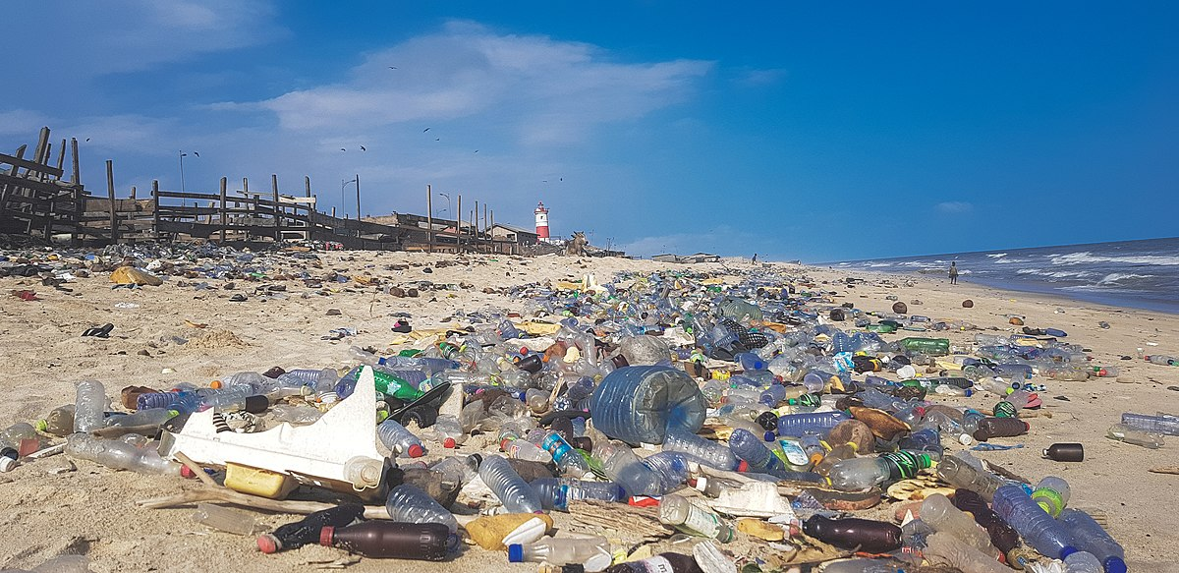
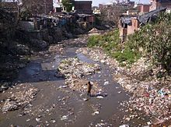
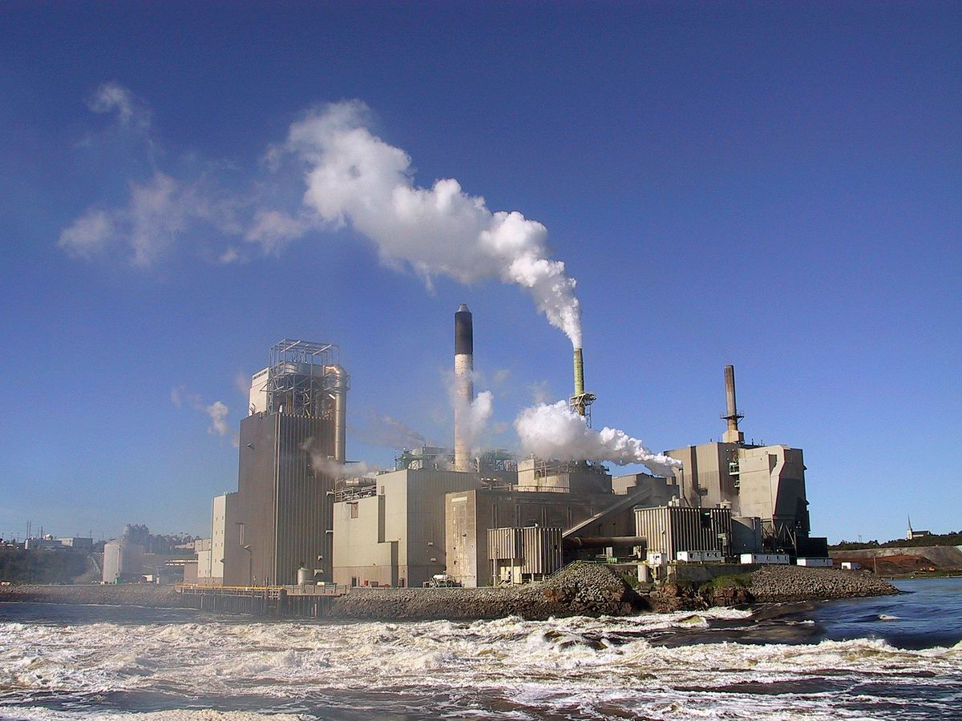
ENVIRONMENTAL POLLUTION
This Photo by Unknown Author is licensed under CC BY-SA

